Slide 1
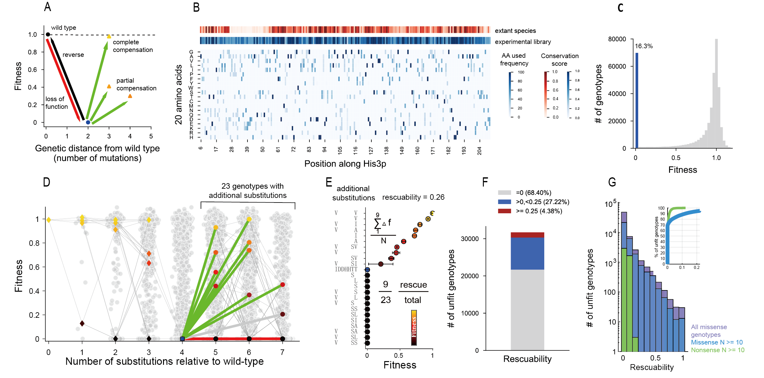
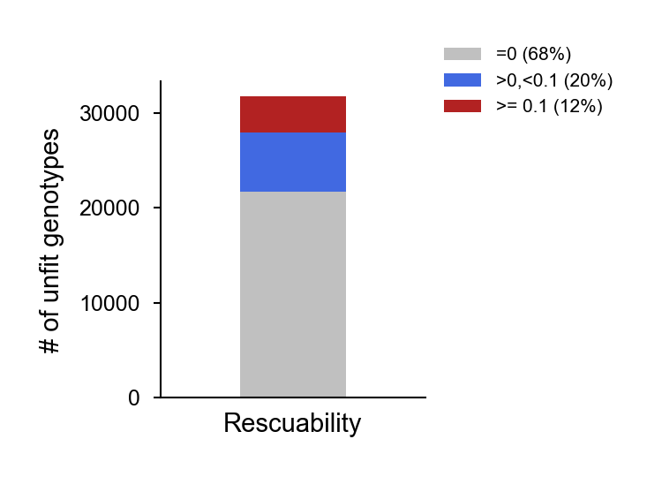
Figure1

Slide 2
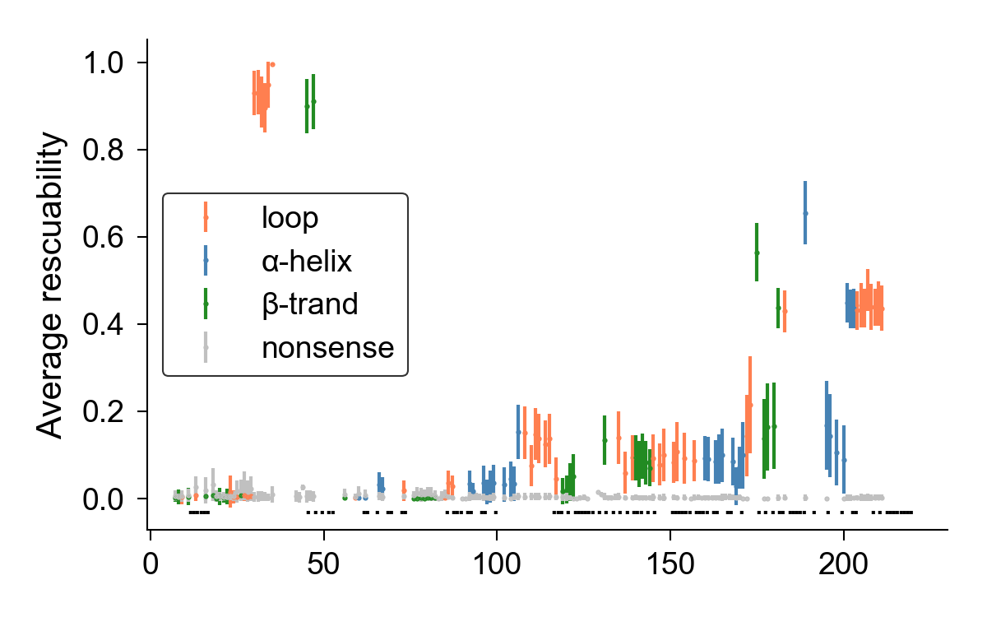
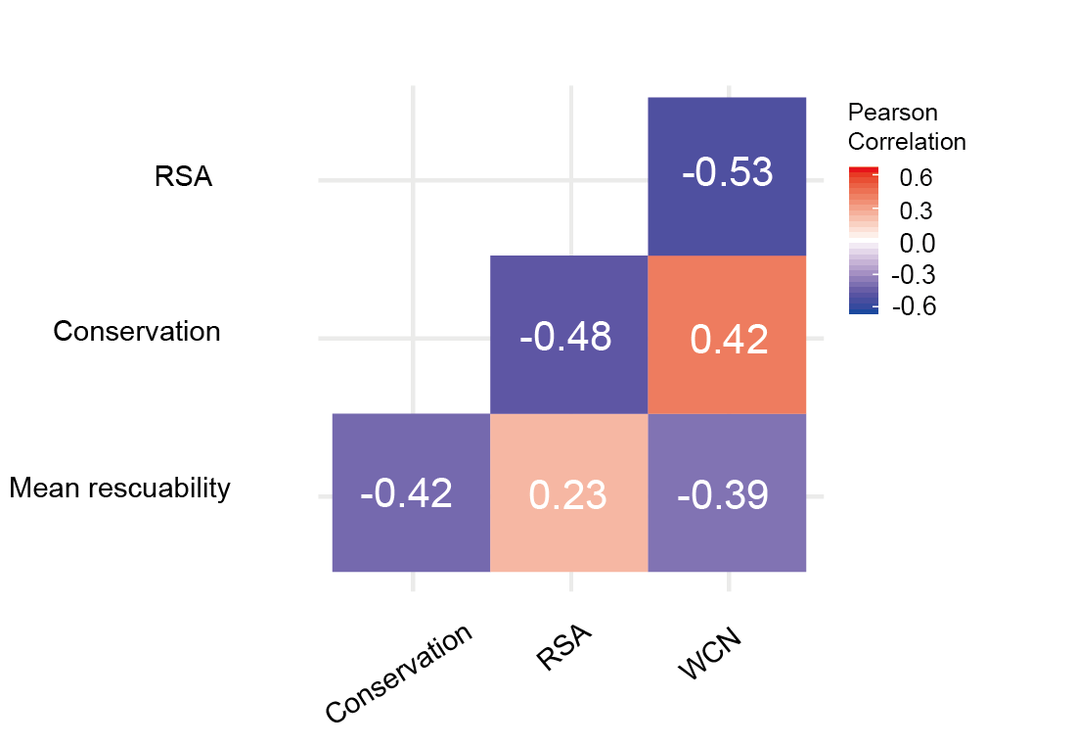
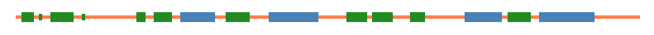
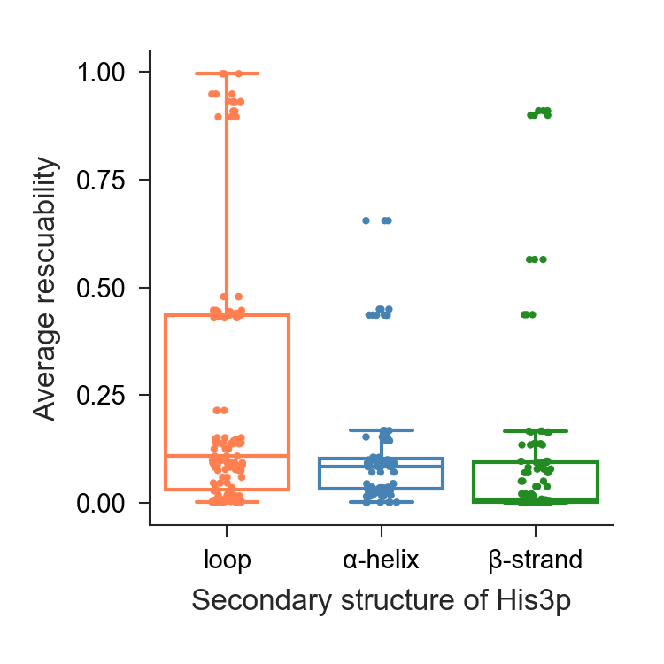
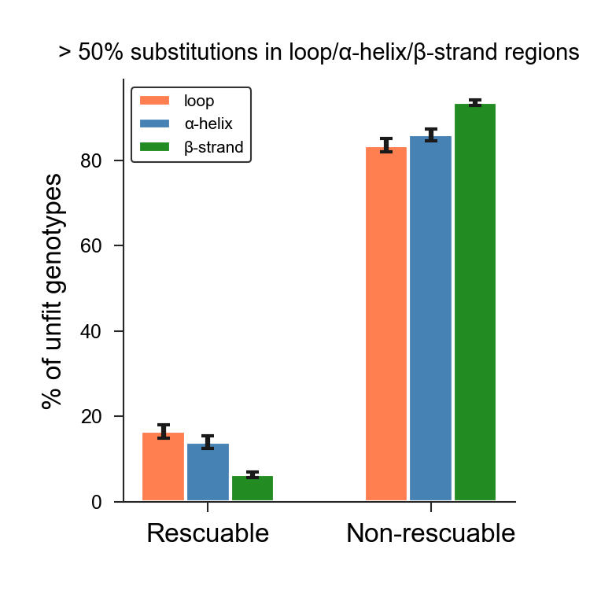
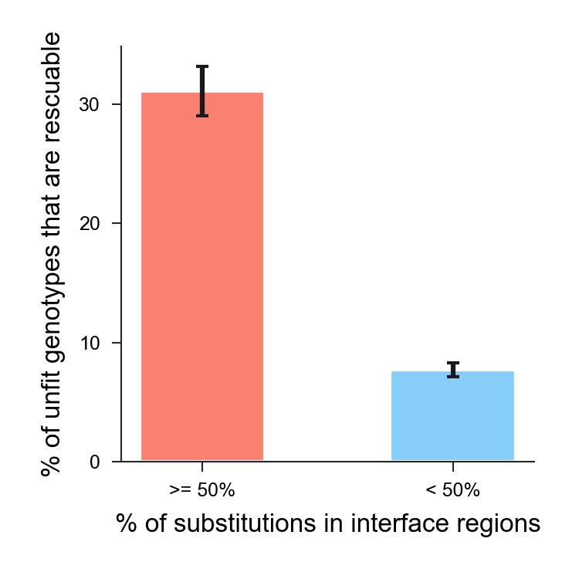
Figure2
A
B
Interface region
Average rescuability
Position along His3p
C
D
E
p:0.00052
p:0.023
p:0.012

Slide 3
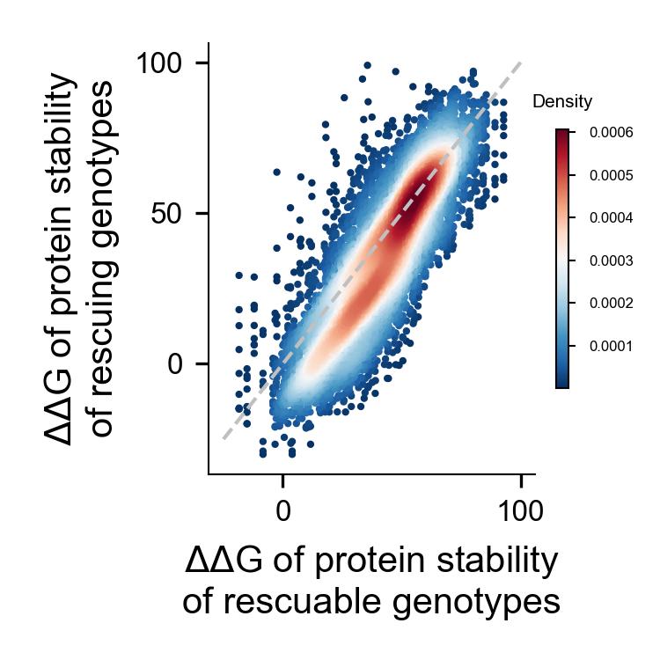
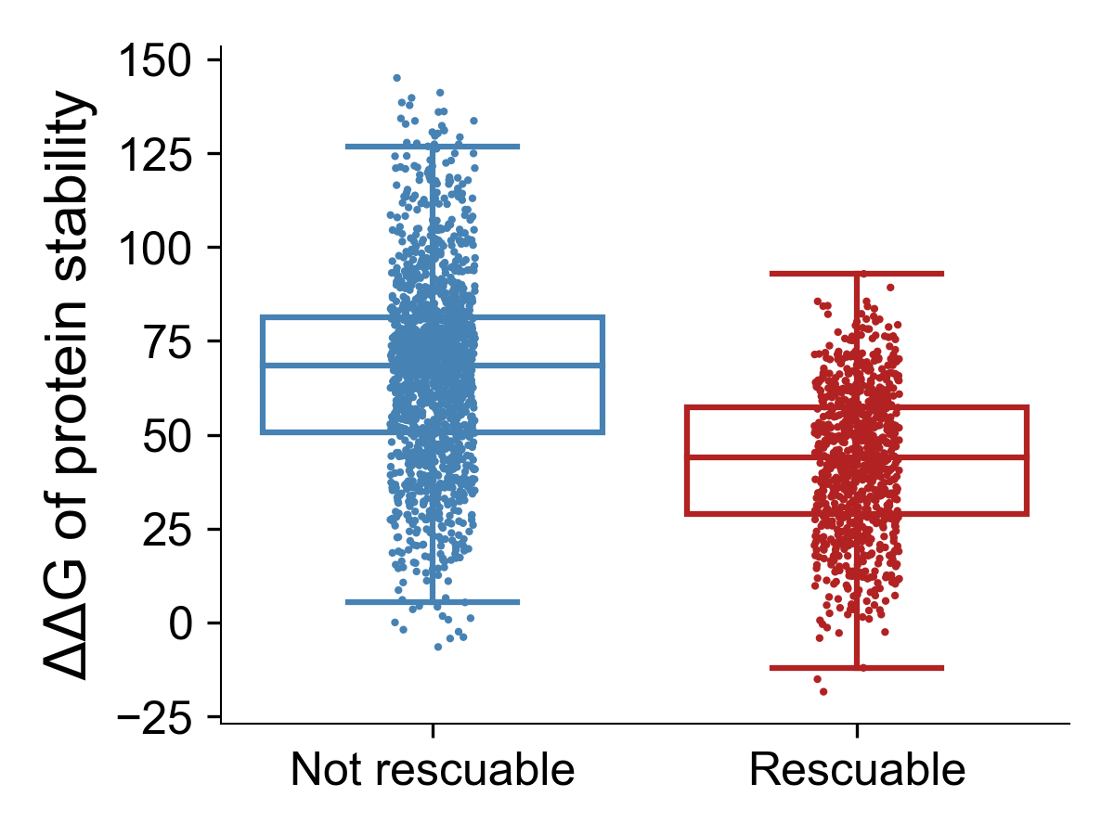
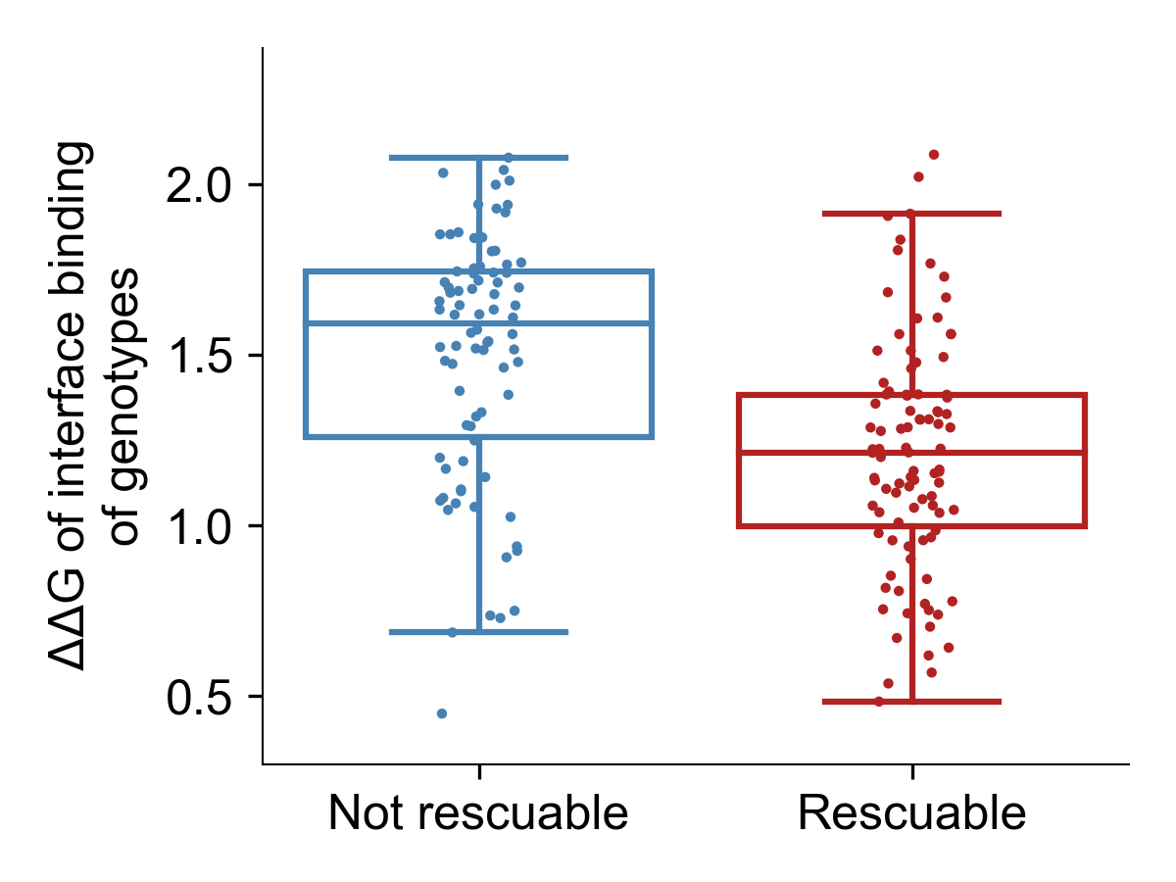
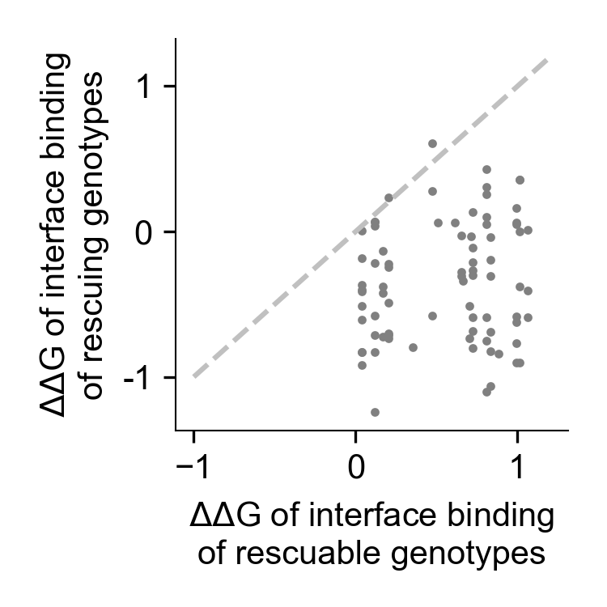
Figure3
A
B
p:3.8e-128
stability
C
D
p:5.8e-8
stability

Slide 4
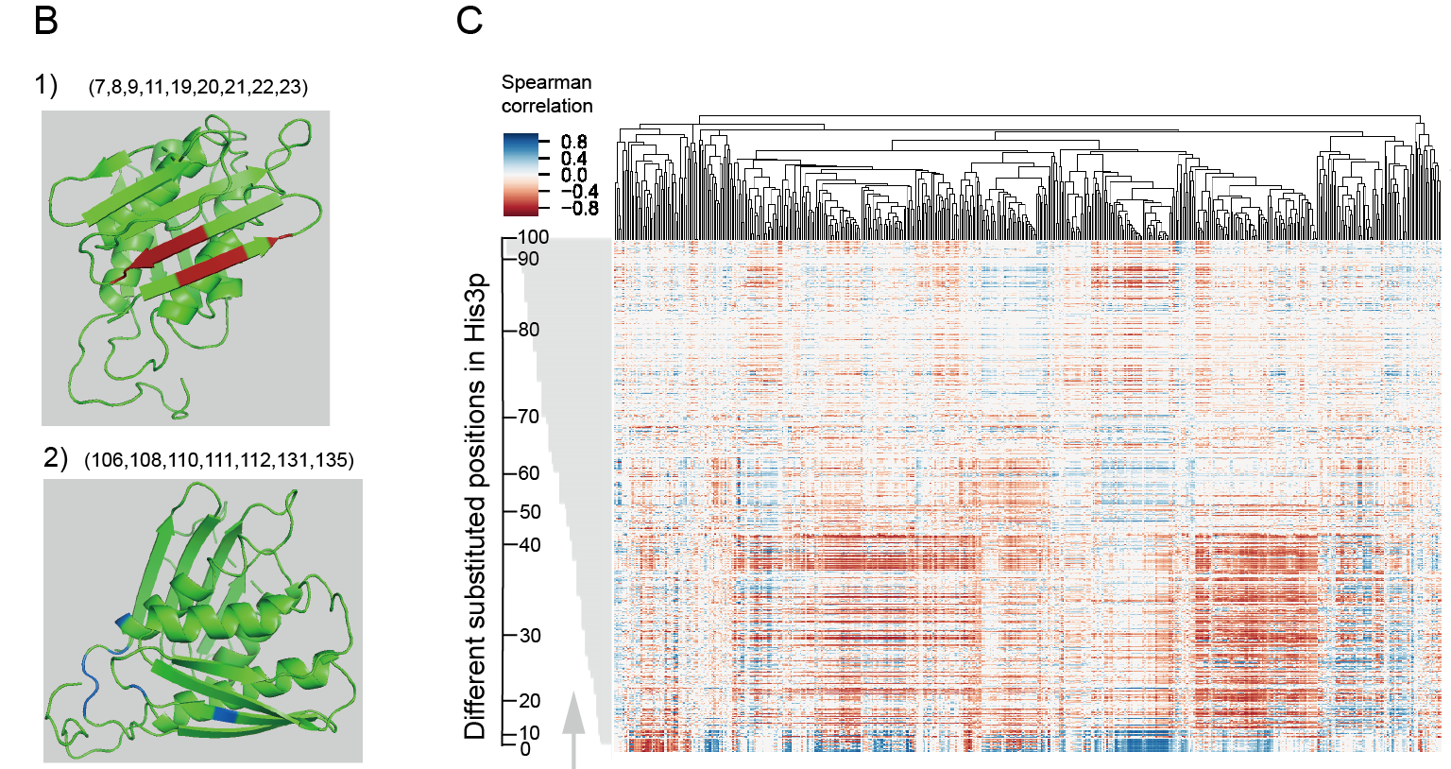
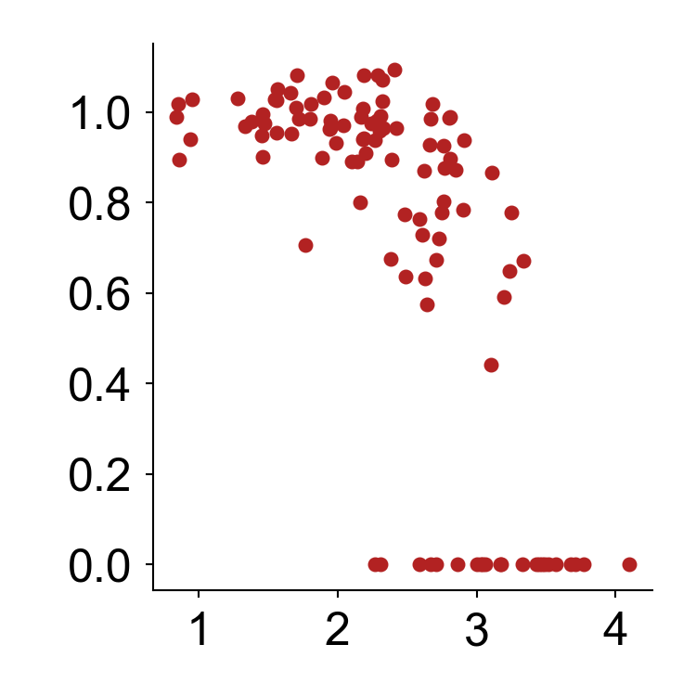
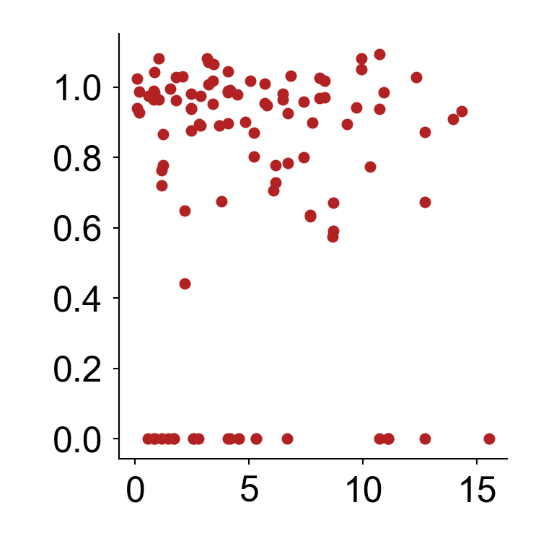
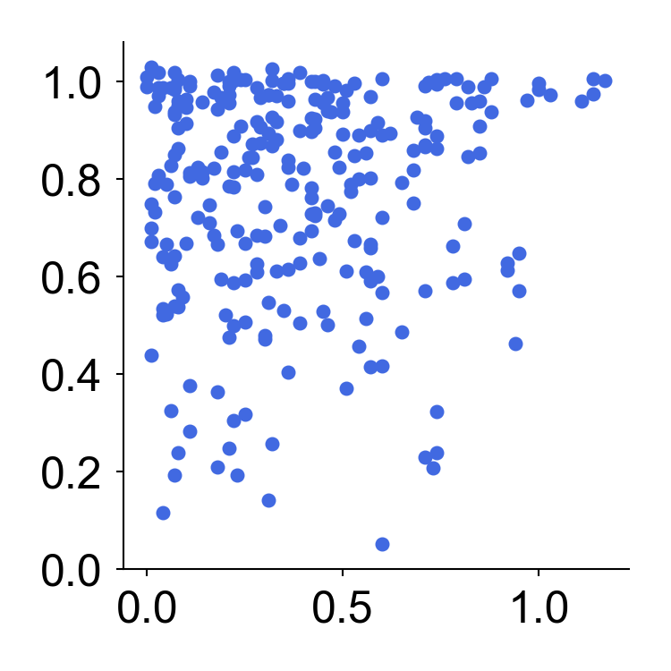
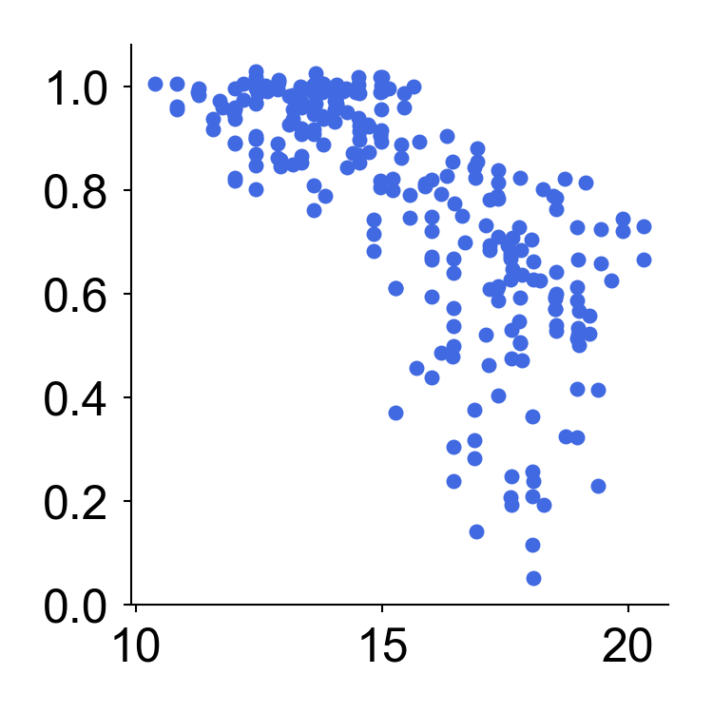
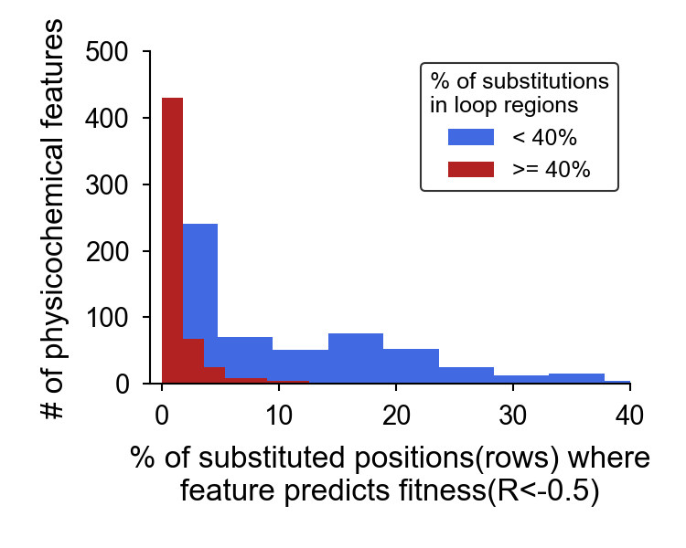
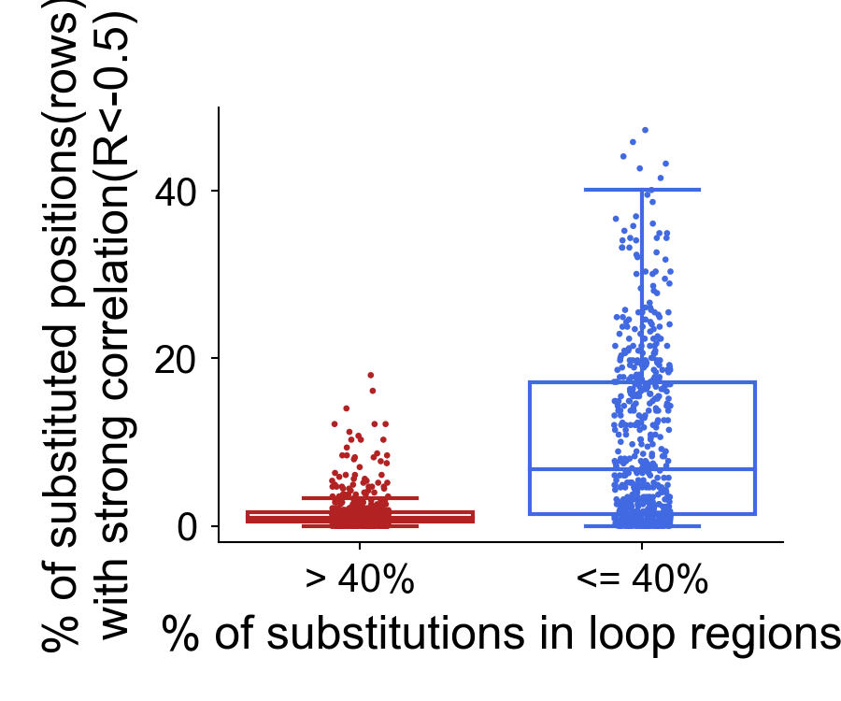
Figure4
A
CRAJ730102
KARS60109
1）
2）
R:-0.71
p: 2.8e-17
R:-0.01, N.S.
Fitness
(7,8,9,11,19,20,21,22,23)
3）
4）
R:0.07, N.S.
R:-0.76
p:7.7e-51
(106,108,110,111,112,131,135)
% of substitutions in
loop regions
553 physicochemical features of amino acids
AAindex value distance to WT
D
E
p:3.5e-61

Slide 5
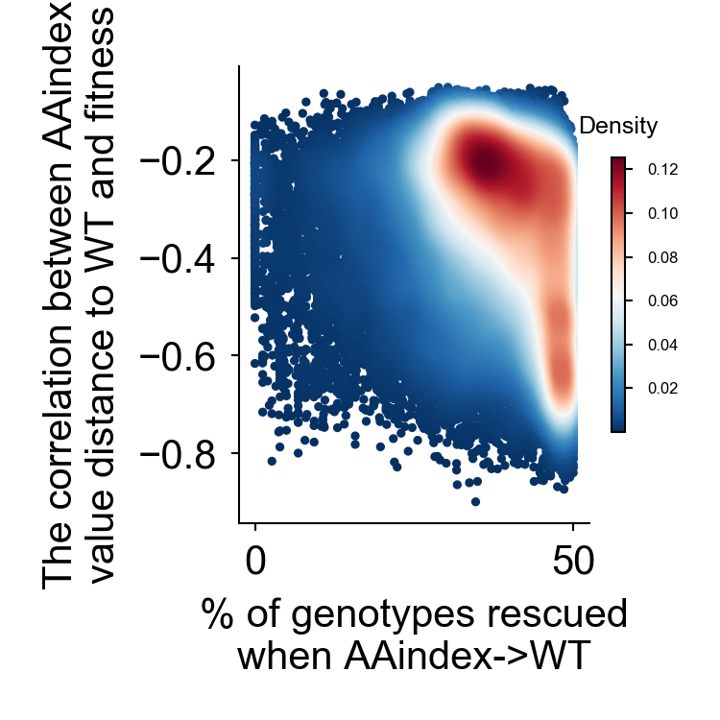
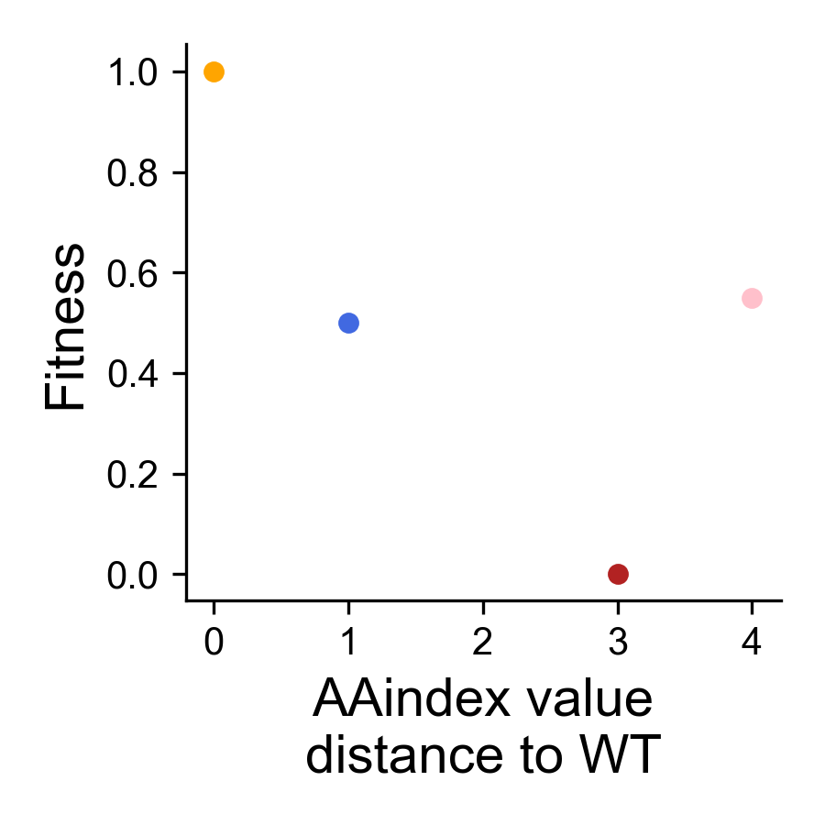
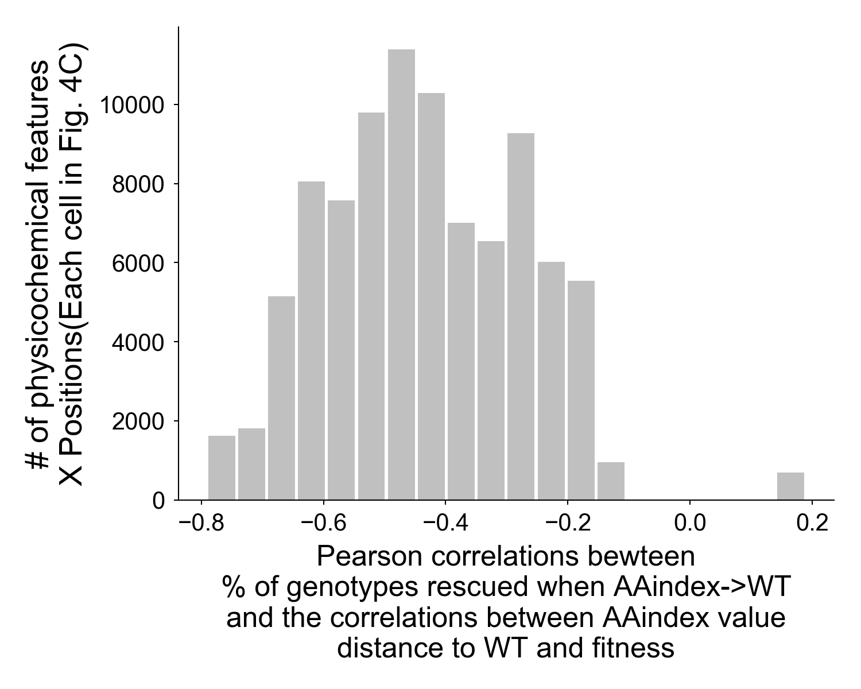
Figure5
A
feature cannot predict
compensation (total:N1)
B
R: -0.32, p: 0.0
WT
feature can predict
compensation (total:N2)
C

Slide 6
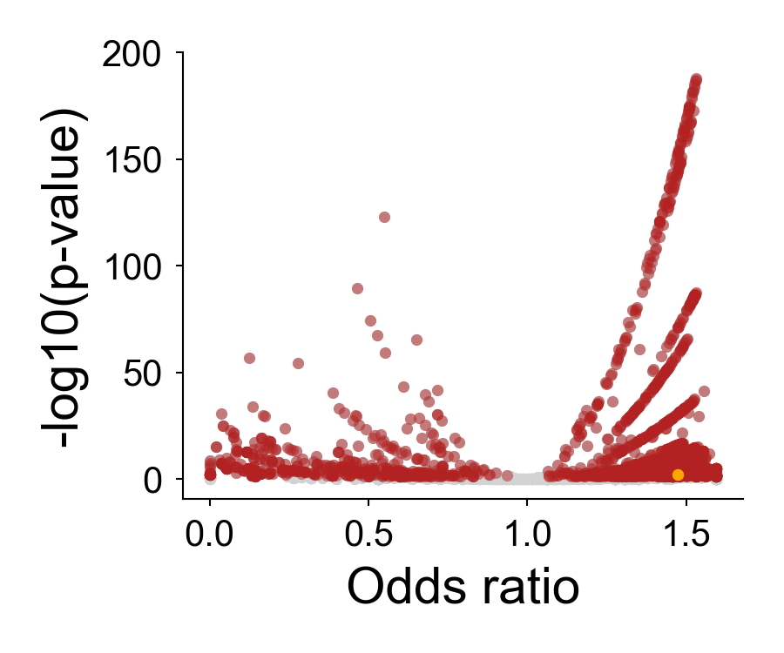
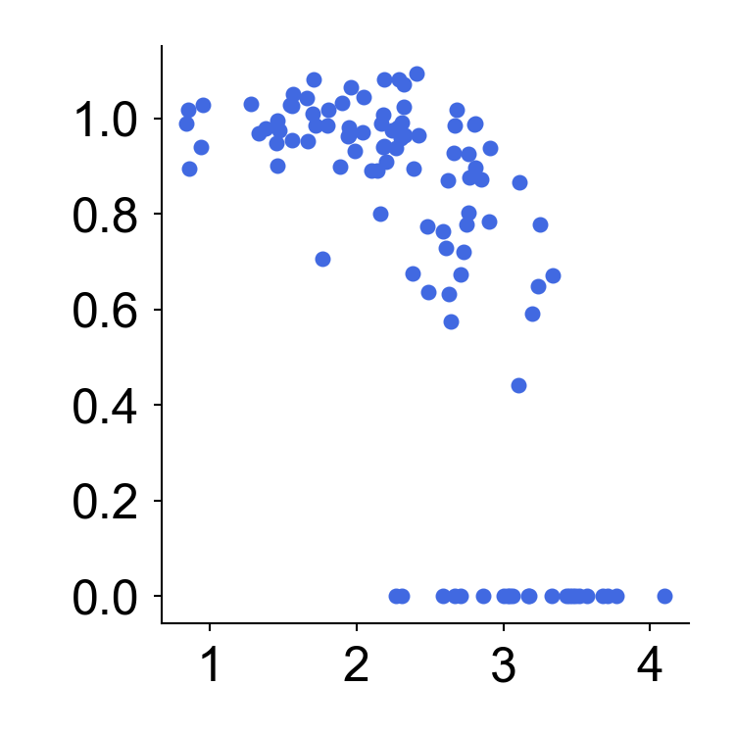
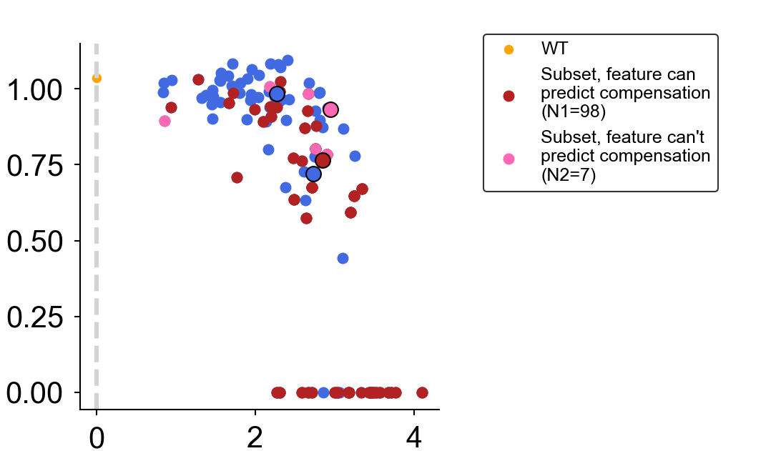
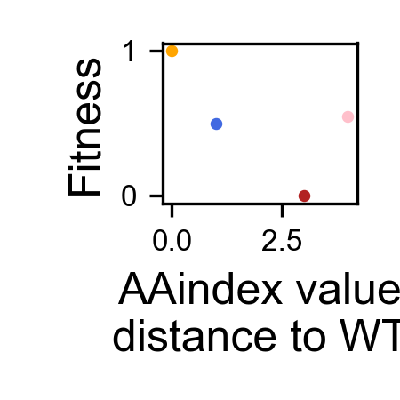
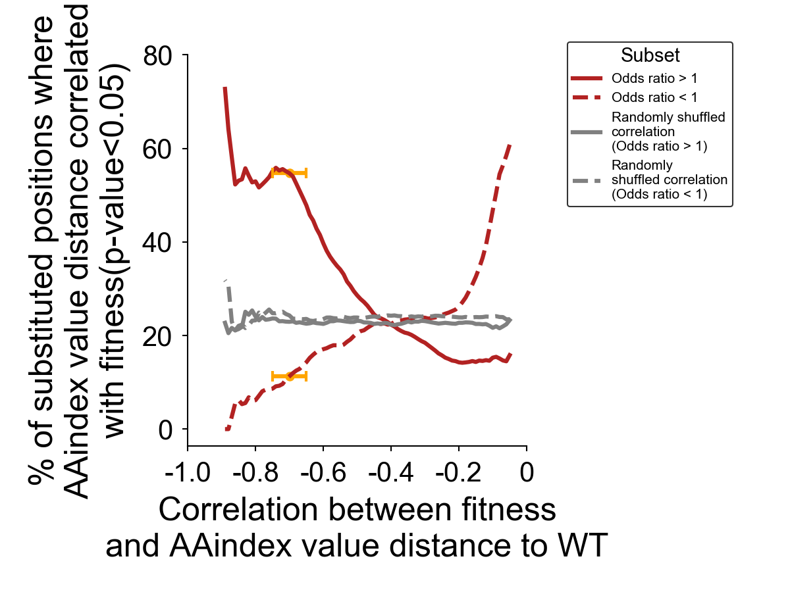
Figure5-2
Fisher exact test
C
subset, predictive data N1 = 98 ∑N1
subset, all data N1+N2 = 105 ∑N1+N2
54.7%
11.3%
A
B
Fitness
D
54.7%
AAindex value distance to WT
across positions 7,8,9,11,19,20,21,22,23
11.3%

Slide 7
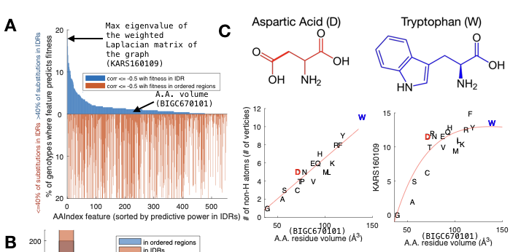
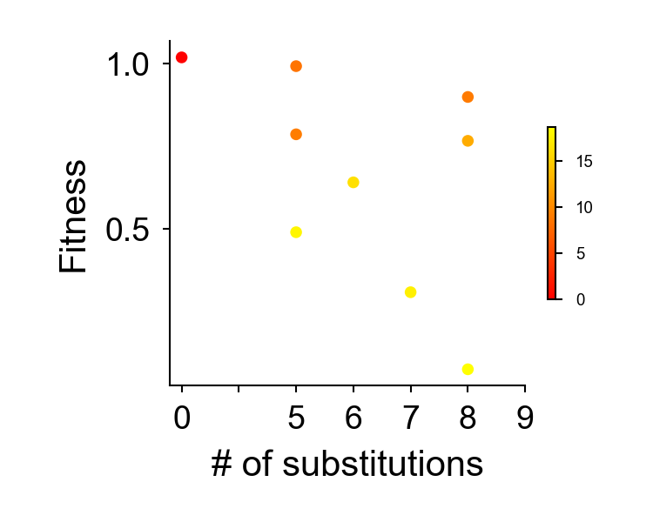
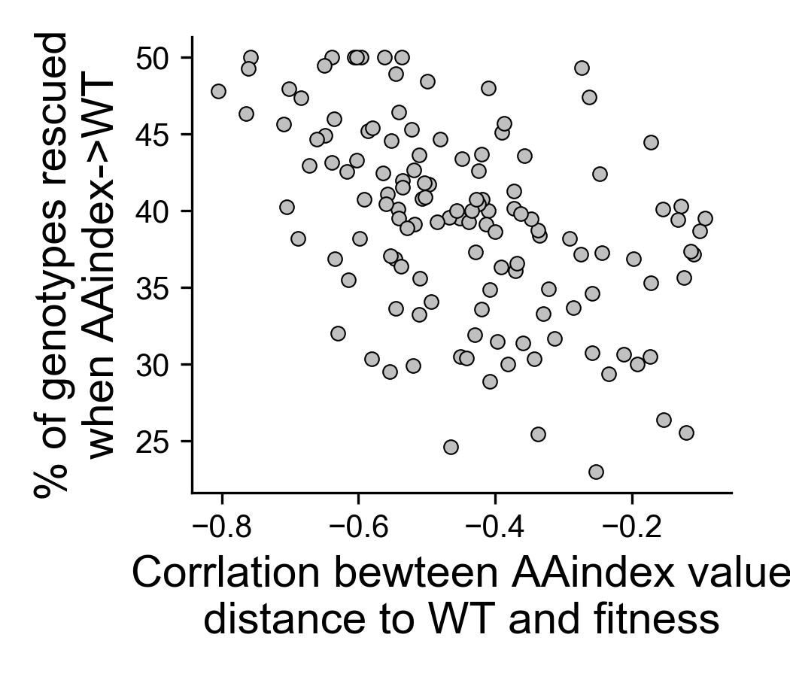
Figure6
B
D
KARS160109 value
distance to WT
R:-0.48,
p:3.78e-9

Slide 8
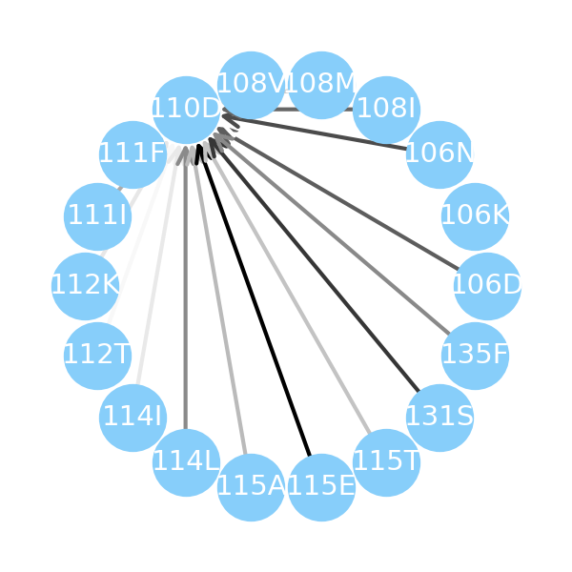
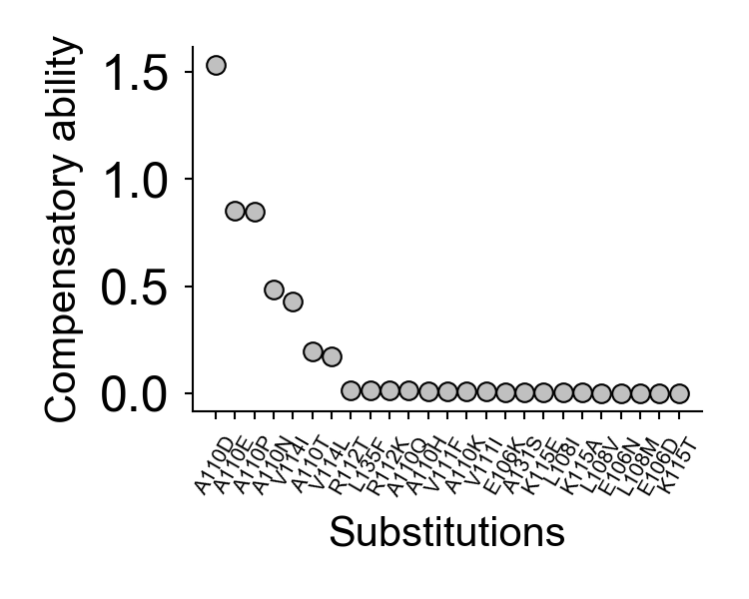
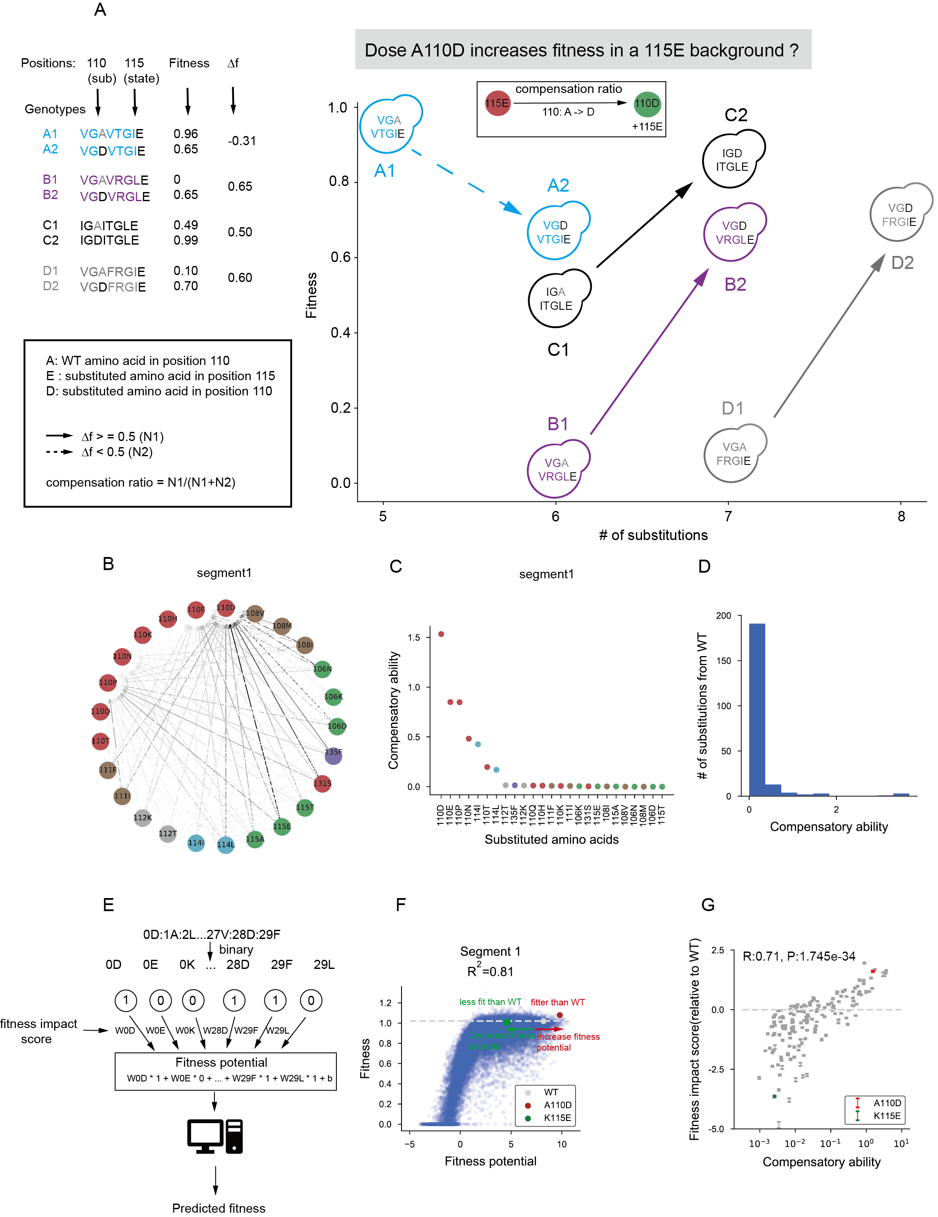
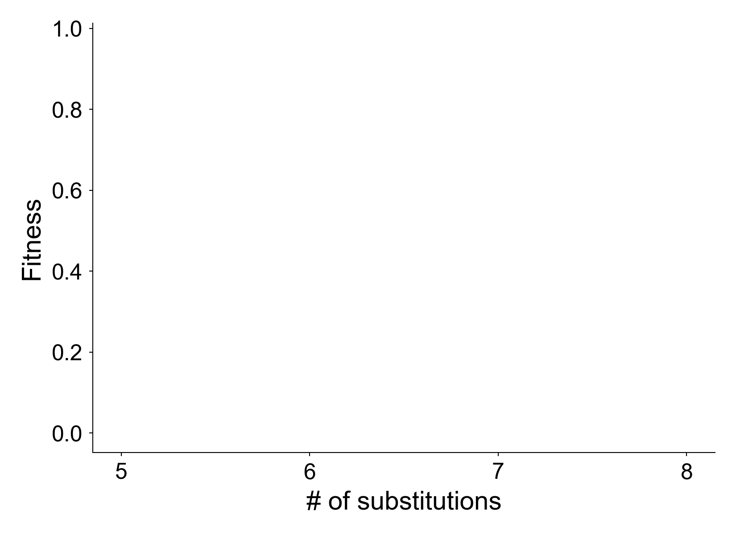
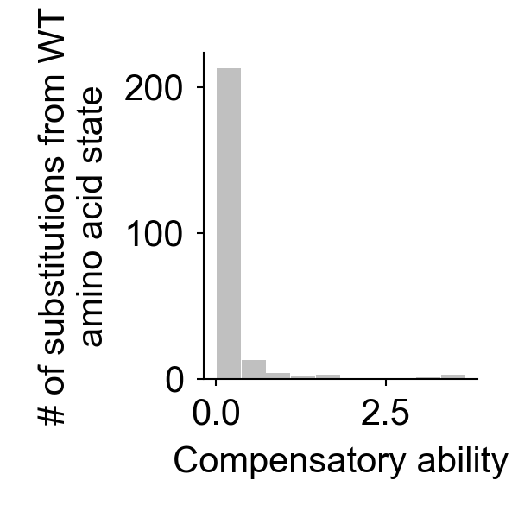
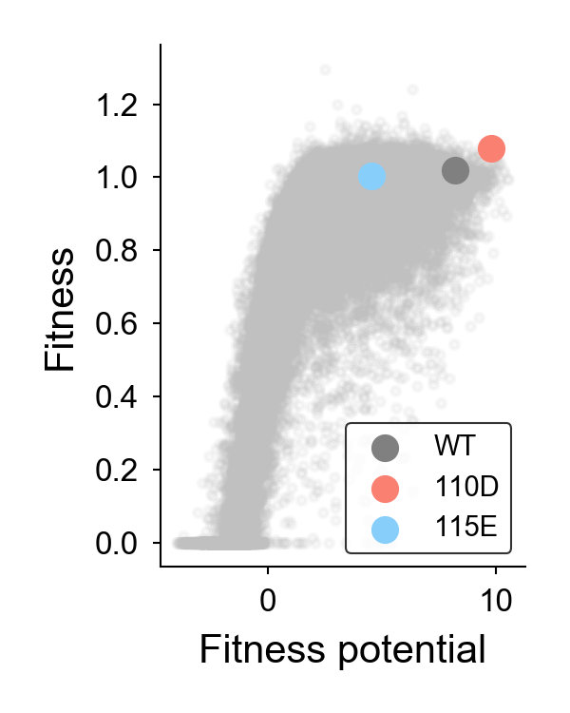
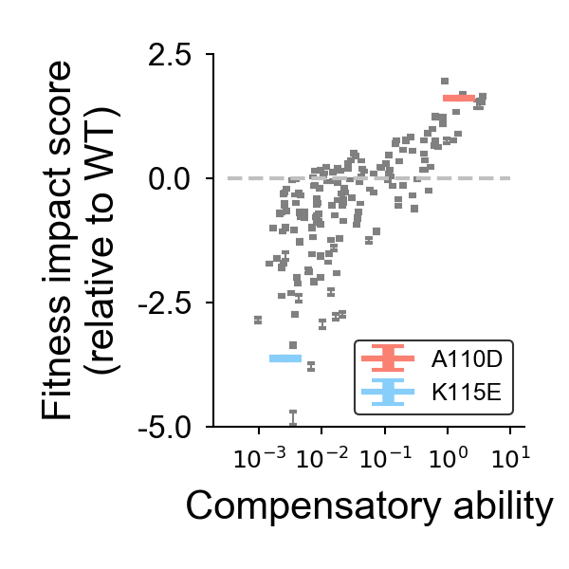
B
C
Figure7
A110D
A
D
E
A: WT amino acid in position 110
D: substituted amino acid in position 110
E: substituted amino acid in position 115
(FI score)
Compensation
ratio
Compensation ratio
= N1(N1+N2)
115E
A110D
F
G
+115E
decrease fitness potential,
decrease fitness
increase fitness potential,
increase fitness
Normalized FI score

Slide 9
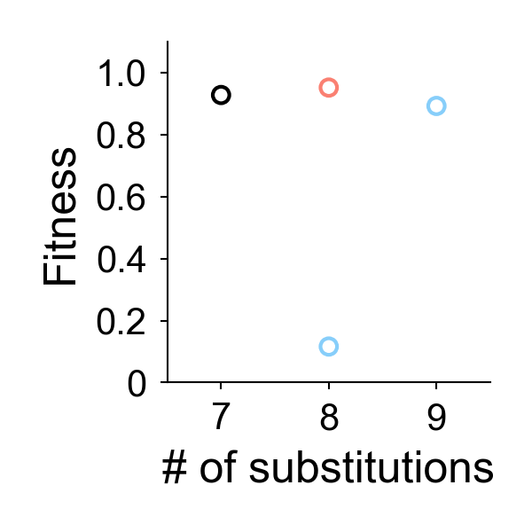
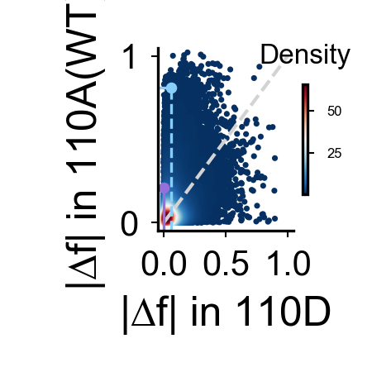
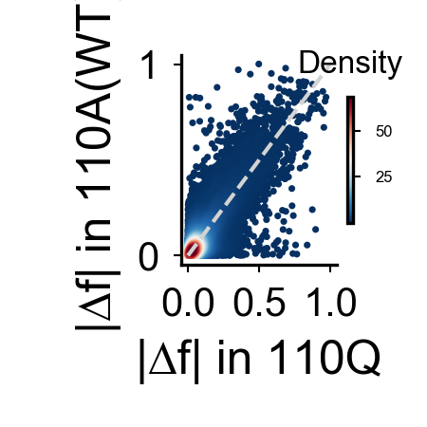
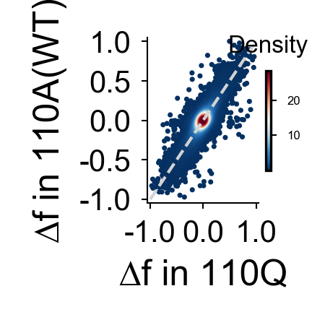
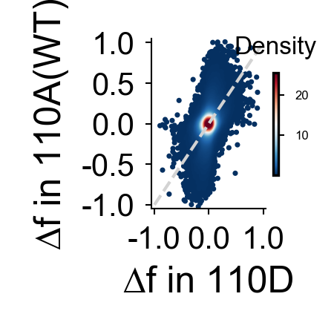
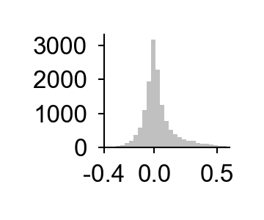
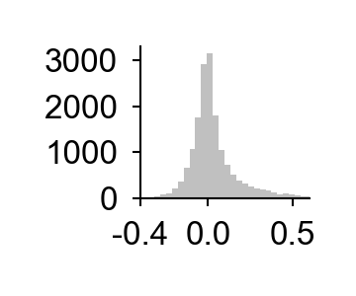
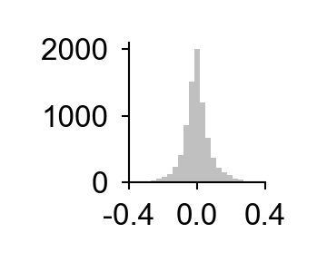

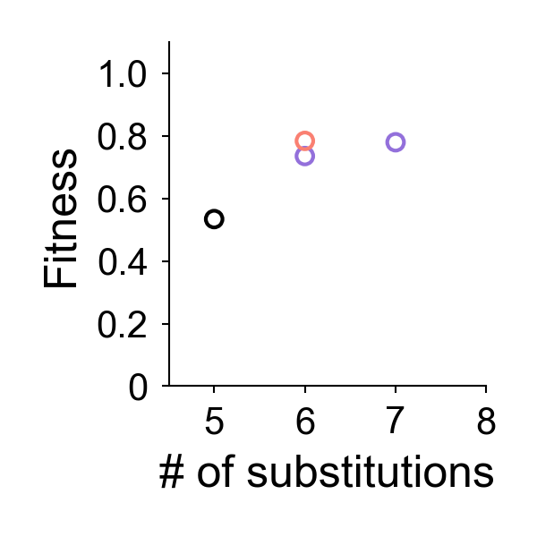
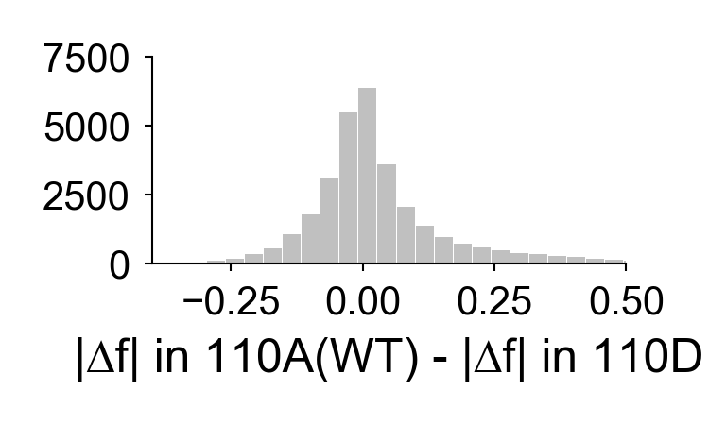
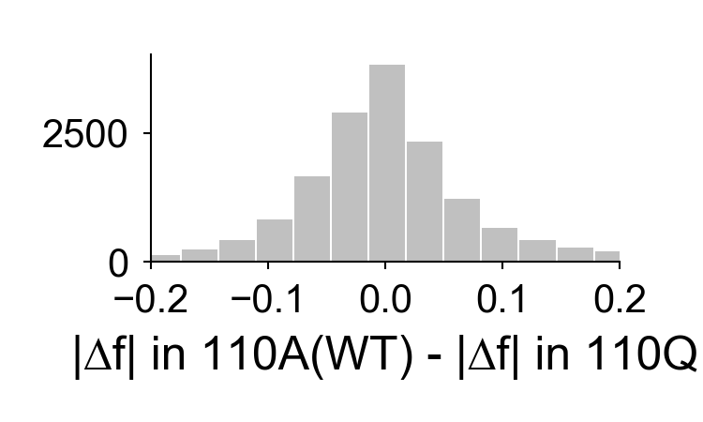
Figure8
D
K115T
Position:110 115 110 115
AIKGLK AIKGLT (0.12) 0.81
DIKGLK DIKGLT (0.89) 0.06
V114I
Position:110 114 110 114
AVTGVT AVTGIT (0.74) 0.21
DVTGVT DVTGIT (0.78) 0.00
absolute △f
C
The fitness effects of K115T(deleterious)
and V114I (beneficial) are both smaller in
a 110D(super-compensator)background.
A
E
F
G
H
110
115
K->T
115
K->T
K115T
V114I
increase
fitness
decrease
fitness
increase
fitness
decrease
fitness
I
J
K
L
B
Skewness
= 1.36
Skewness
= 1.40
Skewness
= 0.04
Skewness
= -0.06
114
110
V->I
merge
merge
M
N
114 V->I
Skewness = 1.38
Skewness = -0.01

Slide 10
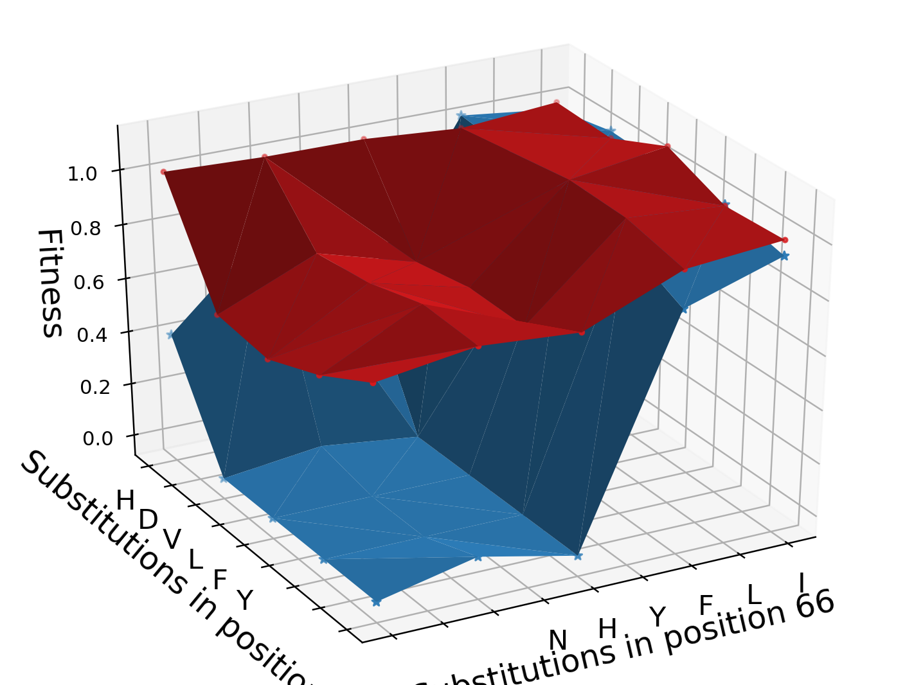
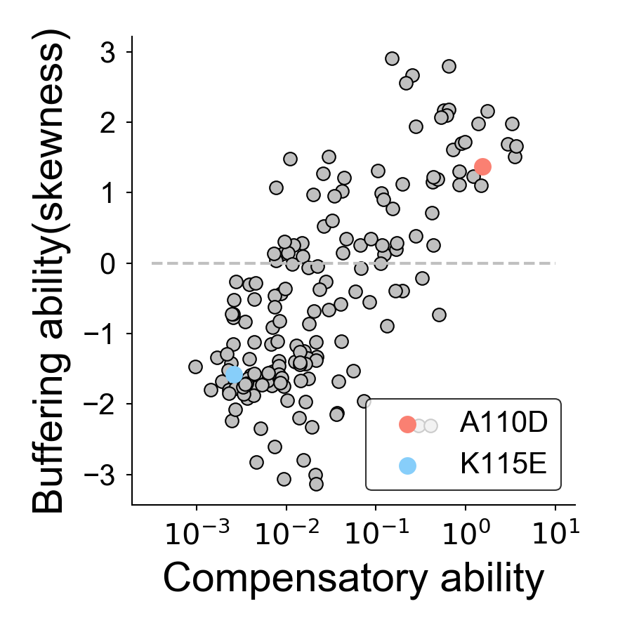




Figure9
A
Figure9
Local fitness landscape with 93V(SC)
E
Local fitness landscape with 93T(WT)
R:0.67, P:1.0e-28
C
skewness: 1.60
Substitutions in position 86
Substitutions
fitness impact score
bigger than WT
B
115E: -1.86
110D:1.60
F
D
R:0.78, P:1.2e-43
F.E. insensitive
region
skewness: -1.86
F.E. sensitive
region
fitness impact score
smaller than WT
Normalized FI score

Slide 11


Figure10
P:0.25
P:0.029
P:1.7e-11
Normalized FI score
High normalized FI score
in the same pair
other AA is:
beneficial deleterious
Average normalized FI score(increase)
This AA is:
deleterious beneficial

Slide 12


Figure11
A
B
R:-0.74, P:8.6e-39
Normalized FI score

Slide 13


Figure 12

Slide 14



FigureS1
Fraction of unfit genotypes
(fitness=0)
# of genotypes with additional
substitutions
Position along His3p

Slide 15





FigureS2
A
B
E
F
Conservation
Conservation
RSA
RSA
Average
rescuability
Average
rescuability
Conservation
RSA
WCN
RSA
WCN
C
D
G
Conservation
Conservation
RSA
Average
rescuability
R2:0.84, R:0.95
p:0.00
Conservation
RSA
WCN

Slide 16




FigureS3
A
B
C
D

Slide 17






FigureS4
A
B
C
D
p: 8.4e-4
E
p: 3.5e-3
F
p: 2.7e-3
p: 0.25
p: 5.4e-3
p: 2.2e-2

Slide 18





FigureS5
A
B
C
D
E
R2:0.60, R:0.78
p:0.00

Slide 19


FigureS6
A
p:1.7e-9
p:2.9e-7
p:6.7e-36
p:4.6e-11
p:5.1e-22
p:2.3e-3
p:2.4e-4
stability
B
p:4.4e-3
p:5.2e-2
p:1.3e-4
p:7.6e-3
p:4.0e-2
p:2.6e-2
stability

Slide 20

FigureS7

Slide 21



FigureS8
R = -0.78,
p: 4.53e-5

Slide 22


FigureS9
A
B
Compensatory ability
Substitutions

Slide 23

FigureS10
Fitness
Fitness potential

Slide 24



FigureS11
double mutants
A
B
Brightness of mutants
with 161V(WT)
Brightness of mutants
with 161A
C
double mutants
Brightness of mutants
with 218L(WT)
Brightness of mutants
with 218P

Slide 25










FigureS12

Slide 26

FigureS13
Distance (A)
Compensatory score

Slide 27



A
FigureS14
D
B
E
% rescuable genotypes
C
% of rescuable genotypes
(rescuability>0.1)
Average normalized FI score
# of substitutions

